Slide 1

Numpy, Pandas, Visualization - Part 3
Pandas Introduction, Pandas Series

Slide 2
Introduction

Slide 3
Introduction
Pandas is an open source library in python
It is useful in data manipulation and analysis
It provides fast, flexible, and expressive data structures designed to make working with structured (tabular, multidimensional, potentially heterogeneous) and time series data

Slide 4
Applications of pandas
Applications
Natural Language Processing
Statistics
Analytics
Big Data
Recommendation Engine
Stock Prediction
Data Science

Slide 5
Pandas vs. Numpy
Pandas | Numpy
It provides some powerful objects like DataFrames and Series | It provides us with a powerful object known as an Array
More streamlined handling of tabular data, and rich time series functionality | Supports fast mathematical computation on arrays and matrices
Easy handling missing data, data alignment, groupby, merge, and, join methods | A wide range of mathematical array operations

Slide 6
Installation
Installing Pandas
Use the following command to install Pandas using jupyter notebook
Importing pandas as alias ‘pd’ is a common practice

Slide 7
Pandas Components
Components of Pandas
One Dimensional
Multi Dimensional
Series
DataFrame
Panel Data

Slide 8
Pandas Series

Slide 9

Pandas series
A Pandas Series is a one-dimensional array of indexed data
Syntax:
To copy the data
Data can be in the form of ndarray, lists
Data type
for the series
Values must be hashable and have the same length as data
Pandas Series can be thought of as a column in the excel sheet

Slide 10
Creating Pandas Series

Slide 11
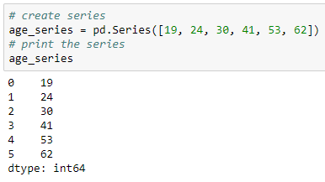
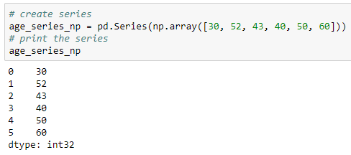
Creating Pandas Series
A pandas series can be created using:
A python list or
A numpy array
Using list
Using numpy array

Slide 12
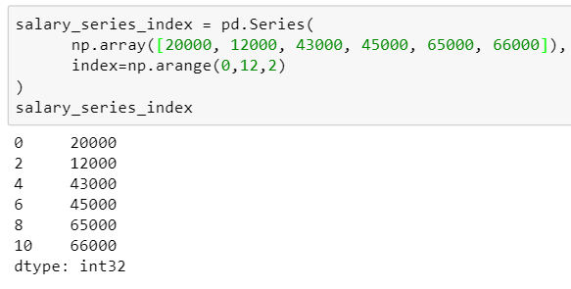
Setting index to series
We can set specify numeric values as index while creating a series
Pass index parameter
By default, index ranges from 0 to (n-1) for series of length ‘n’

Slide 13
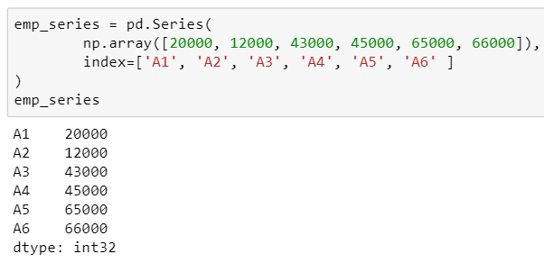
Setting index to series
We can also specify the strings as index values
String as a row index

Slide 14
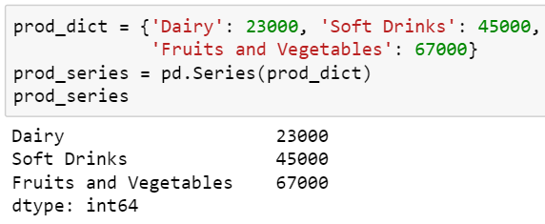
Creating series from dictionary
Keys as index
Values as row values
The key becomes the row index while the value is the row value at that row index

Slide 15
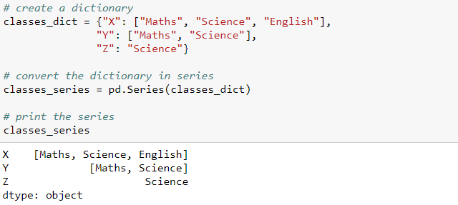
Creating series from dictionary
If you have multiple values for a single key, those multiple values will take up a single row

Slide 16
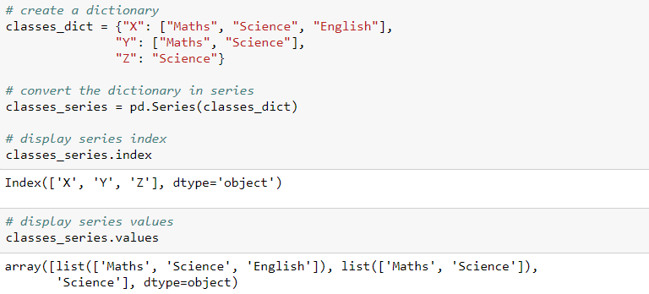
Accessing series index and values
To display the index names and values of the series use index and values attributes respectively

Slide 17
Accessing Series Elements

Slide 18
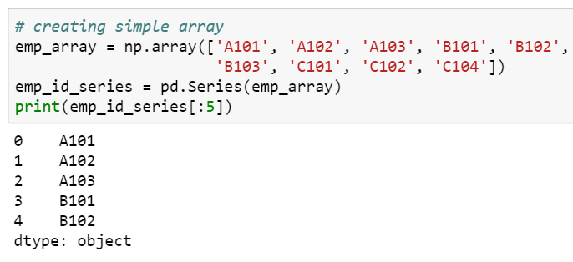
Accessing Series Elements
Access the element in a series using the index operator ‘[]’
Retrieve first five elements

Slide 19
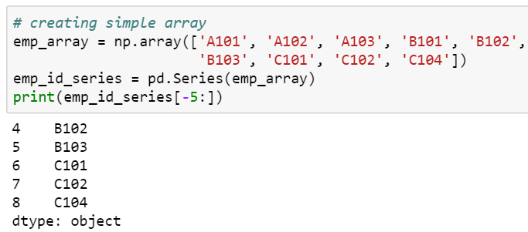
Accessing Series Elements
Retrieve last five elements

Slide 20
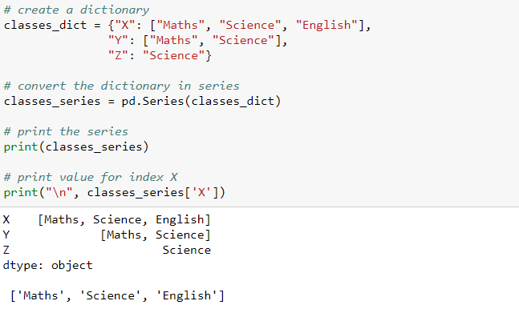
Accessing Series Elements
Use index to access the element

Slide 21
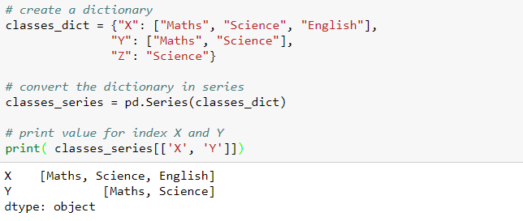
Accessing Series Elements
Retrieve multiple elements using a list of indices

Slide 22
Filtering a Series

Slide 23
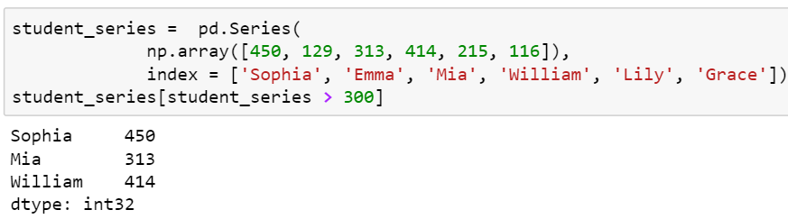
Filter the values
Filter all the values that are greater than 300

Slide 24
Arithmetic Operations

Slide 25
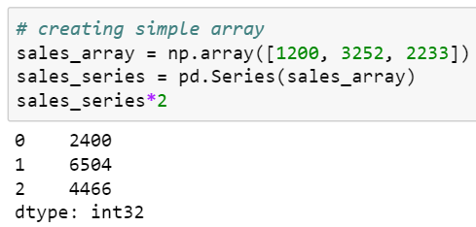
Scalar - Series multiplication
Use ‘*’ operator to perform multiplication
One can also use the multiply() method to perform the multiplication operation

Slide 26
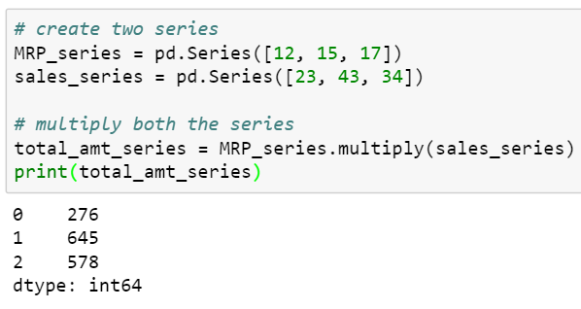
Series - Series multiplication
The multiply() method returns the element-wise multiplication of the two series

Slide 27
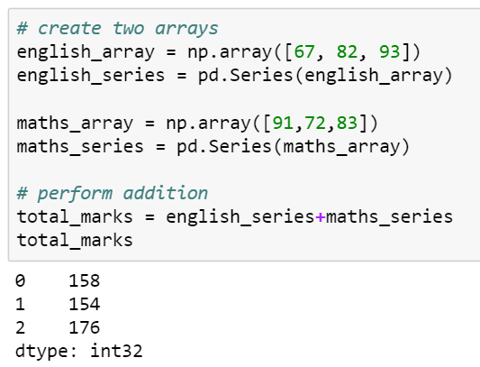
Addition of two series
Use ‘+’ operator to perform addition

Slide 28
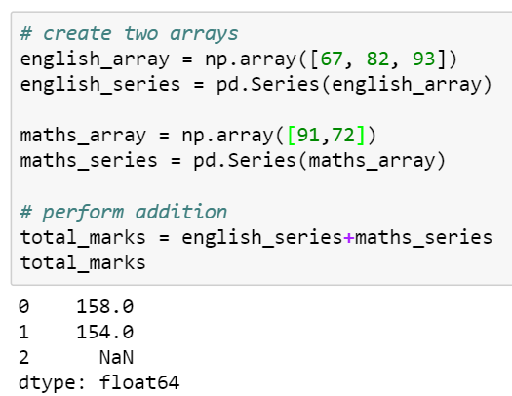
Addition of two series
If the length of the two series are different, then the addition of such series shows the null values (NaN) for the indexes where the values are missing in one of the series

Slide 29
Series Ranking and Sorting

Slide 30
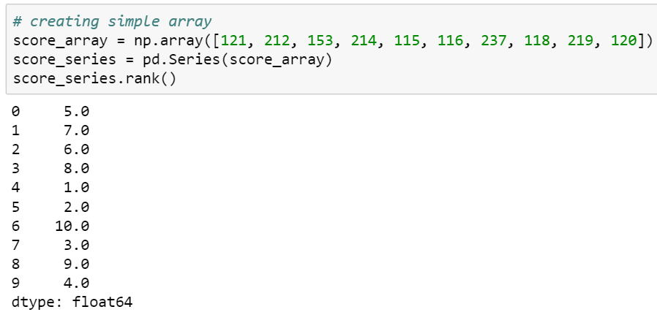
Ranking series
Returns the rank of the underlying data
The rank() method, by default, returns the ranking in ascending order

Slide 31
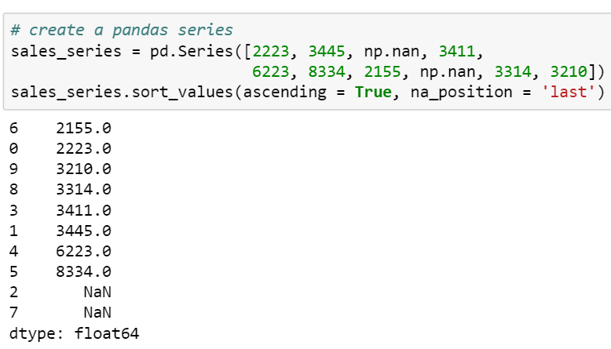
Sorting series
The sort_values() method sorts the series by values in the series
Returns the null values in the last position

Slide 32
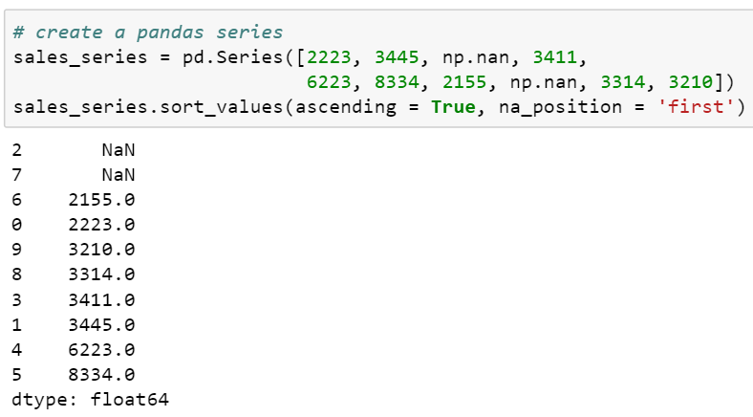
Sorting series
Returns the null values in the first position
‘ascending = False’ sorts the series in descending order

Slide 33
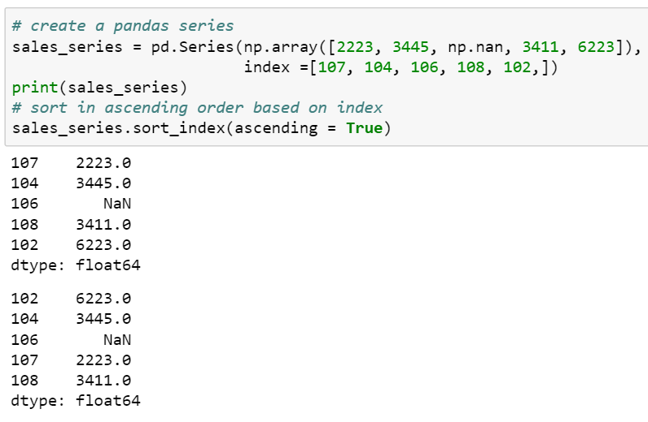
Sorting series
Sort the series by index

Slide 34
Checking Null Values

Slide 35
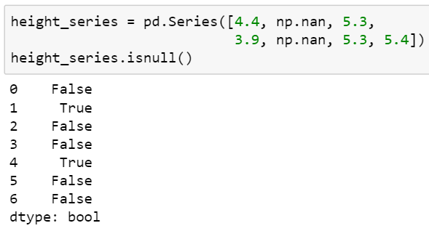
Checking null values
The isnull() method returns the boolean output indicating the presence of null values
‘True’ value indicates that the corresponding value is null

Slide 36
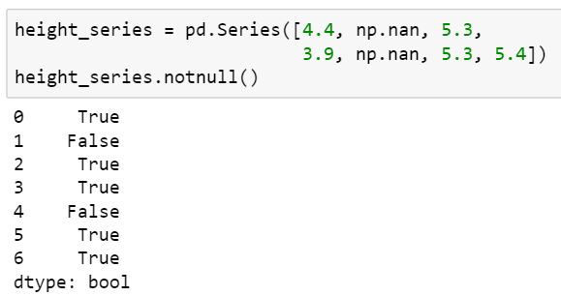
Checking null values
The notnull() method returns the boolean output indicating the presence of non-null values
‘False’ in the output indicates that the corresponding value is null

Slide 37
Concatenate a Series

Slide 38
Concatenate a series
Creates a new series by appending a series with another series
The concat() and append() methods are used to concatenate a series
One can concatenate more than two series

Slide 39
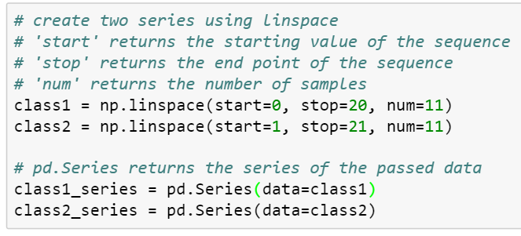
Create a series
Create python series as shown below:

Slide 40
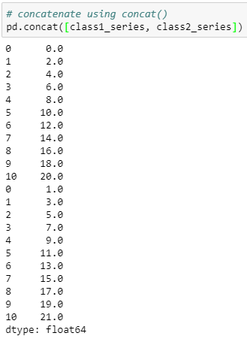
Concatenate a series
The concat() method concatenates a series in the order they are passed in the function

Slide 41
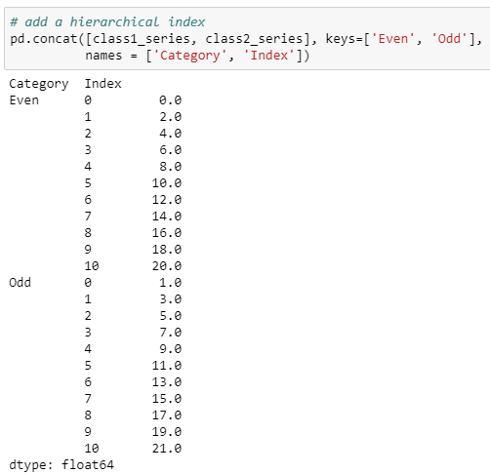
Add hierarchical index and label the index
Add the hierarchical indexes and labels while concatenating two series
Returns the hierarchical indexes
Returns the label of indexes

Slide 42
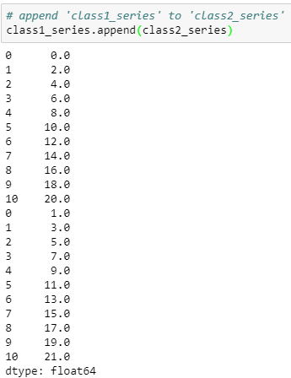
Concatenate a series
The append() method is used append a series with another
Here, we append the ‘class1_series’ to ‘class2_series’
Appended indexes are same as the original series

Slide 43
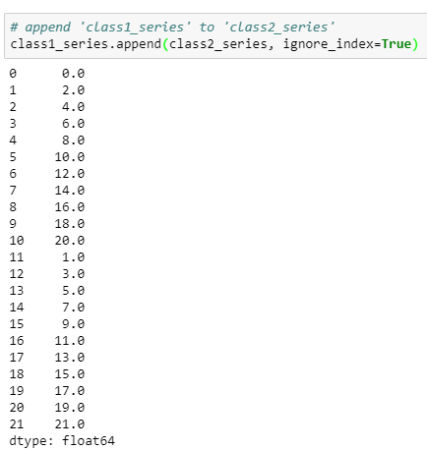
Concatenate a series
Ignores the index labels of original series

Slide 44
THANK YOU
Presenter’s Name
Contact Us
support@knowledgehut.com
Presenter’s Designation

